Slide 1
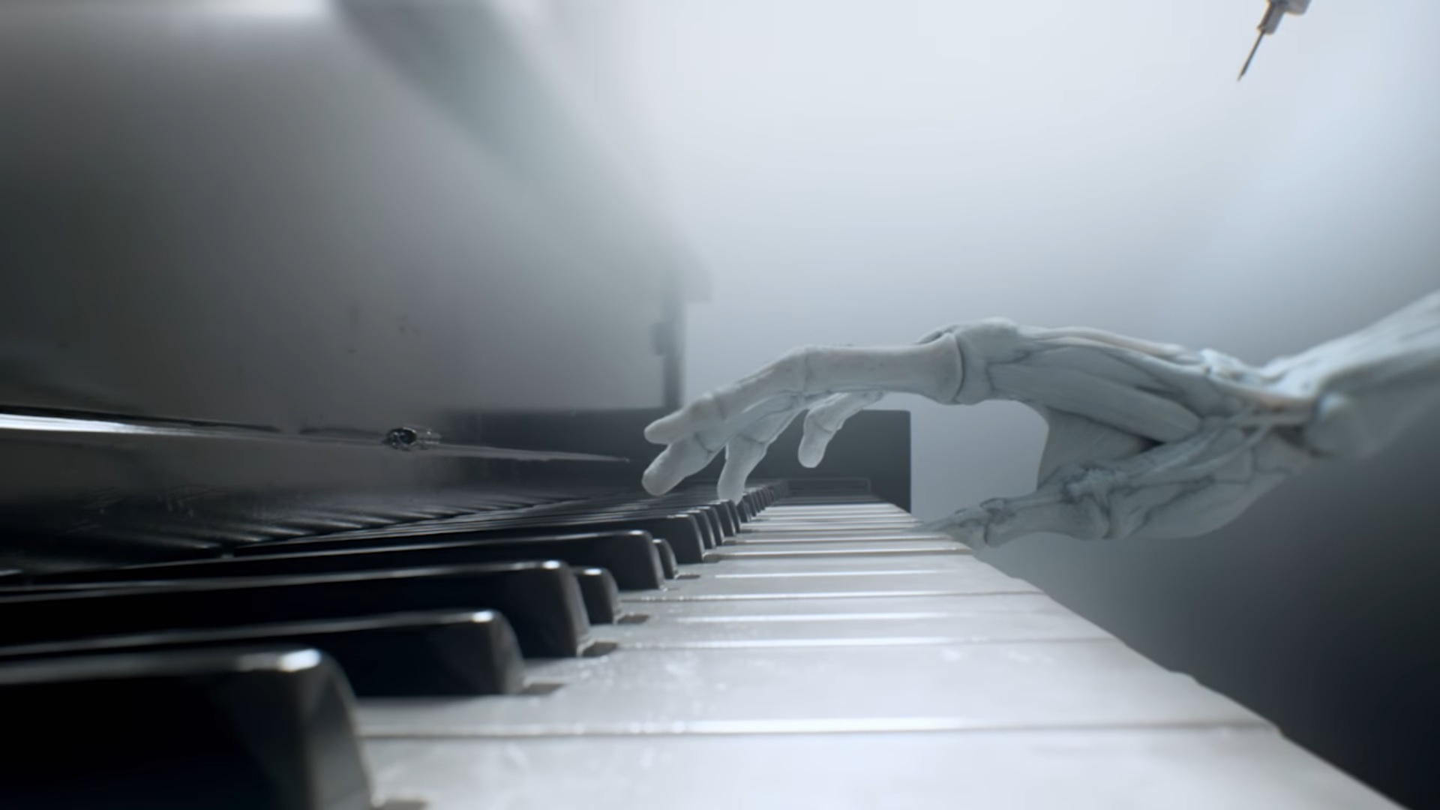
AI Has Been Creating
Results Are ...
Weird
Music and the
by Justin Ma
F E B . 2 8
F E B . 2 8
F E B . 2 8

Slide 2
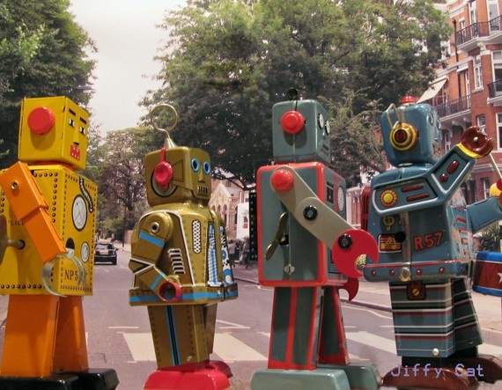
Daddy’s Car
Song generated by Flow Machines software after analyzing music from the Beatles.
Human composer, Benoît Carré, arranged/produced the final product and wrote the lyrics, so AI still has a long way to go.

Slide 3
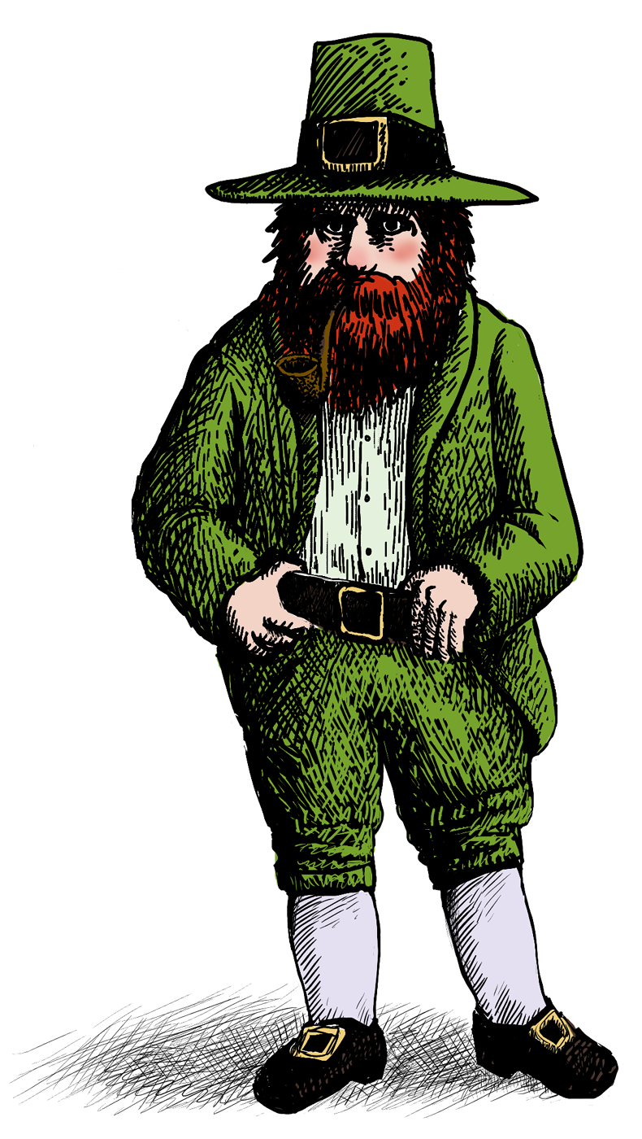
Folk-rnn
AI project developed by researchers at Kingston University and Queen Mary University of London.
Ingested over 23,000 Irish folk transcripts.
Produced over 100,000 of its own song.

Slide 4
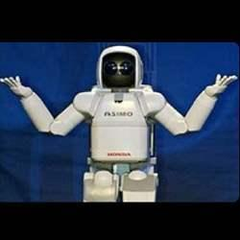
What’s the point?
?

Slide 5
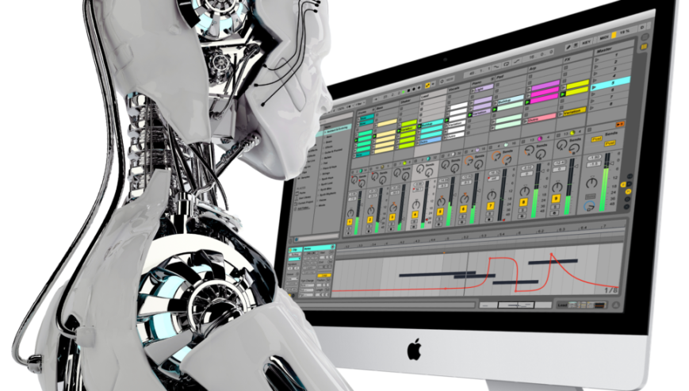
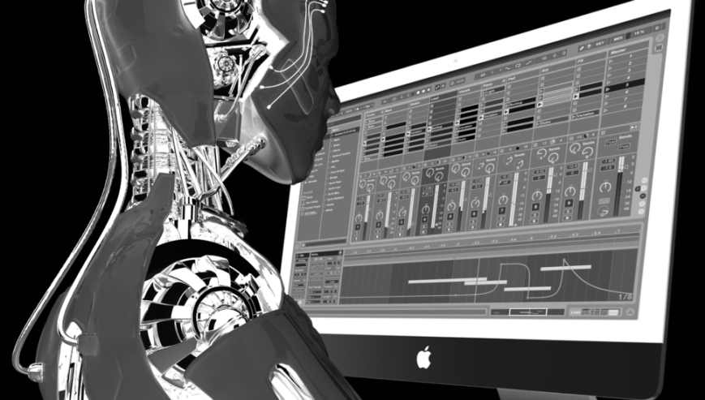
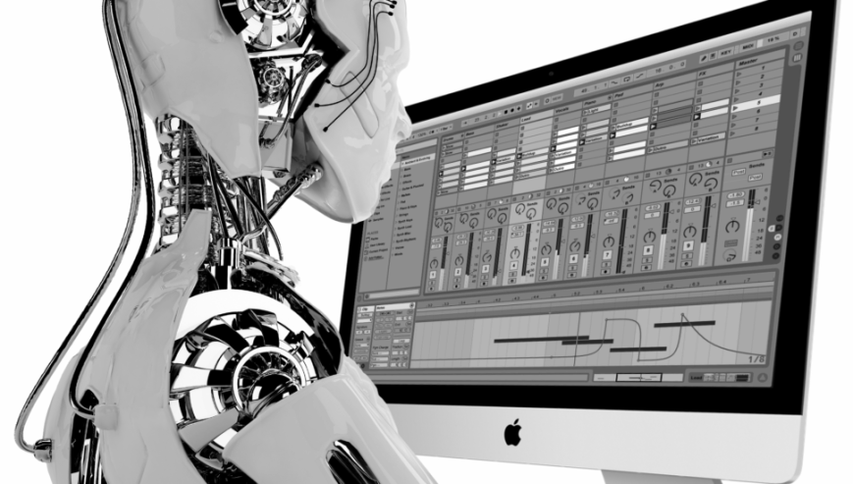
Applications:
//
AI can be used to create soundtracks for commercials or short films.
Jukedeck has created over half a million tracks. Some have even been used by Facebook and Google.
These programs can help musicians compose.

Slide 6
How does it work?

Slide 7
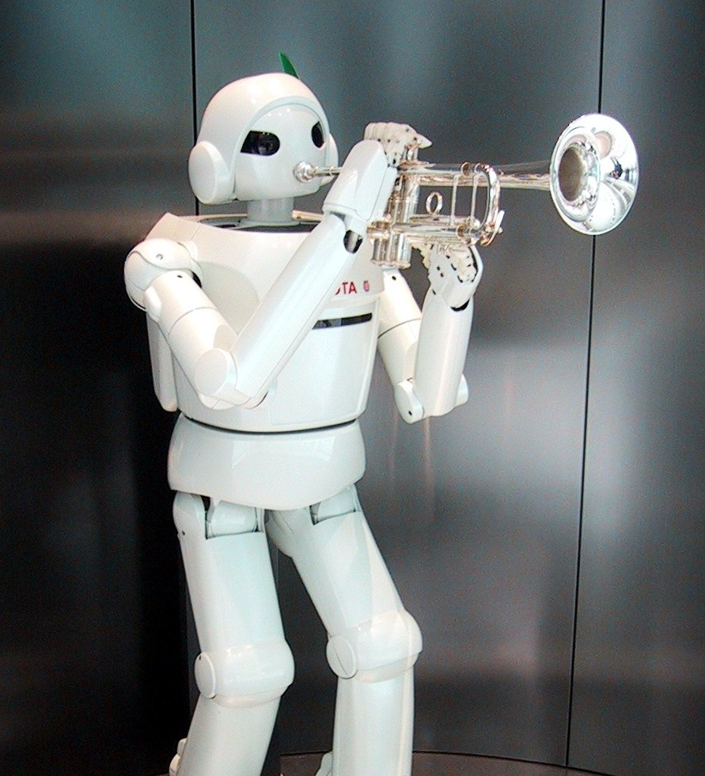
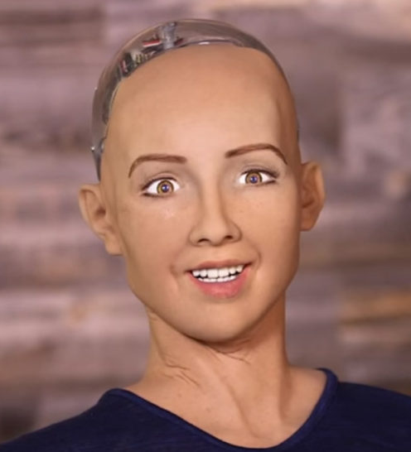
Machine Learning
Supervised
Labeled data
More data gives more accurate results
Unsupervised
Unlabeled data.
Detects hidden patterns
Reinforcement
Defined beginning and end, but up to machine to find path

Slide 8
Machine Learning
Supervised
Labeled data
More data gives more accurate results
Unsupervised
Unlabeled data.
Detects hidden patterns
Reinforcement
Defined beginning and end, but up to machine to find path

Slide 9
Machine Learning
Supervised
Labeled data
More data gives more accurate results
Unsupervised
Unlabeled data.
Detects hidden patterns
Reinforcement
Defined beginning and end, but up to machine to find path

Slide 10
Machine Learning
Supervised
Labeled data
More data gives more accurate results
Unsupervised
Unlabeled data.
Detects hidden patterns
Reinforcement
Defined beginning and end, but up to machine to find path

Slide 11
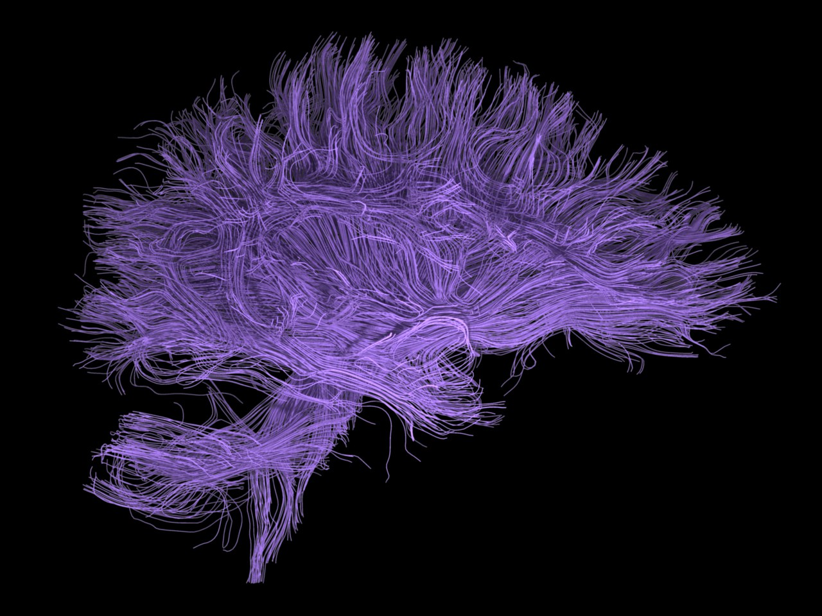
Deep Learning
Uses neural networks, inspired by neuron connections in the human brain.
Many hidden layers that input information goes through before being outputted.

Slide 12
Deep Learning
Recurrent Neural Network
Performs cycle of same task on every input, while depending on previous outputs
Convolutional Neural Network
Selects overlapping sections of data to find areas of interest

Slide 13
Deep Learning
Recurrent Neural Network
Performs cycle of same task on every input, while depending on previous outputs
Convolutional Neural Network
Selects overlapping sections of data to find areas of interest

Slide 14
How will this affect musicians?

Slide 15
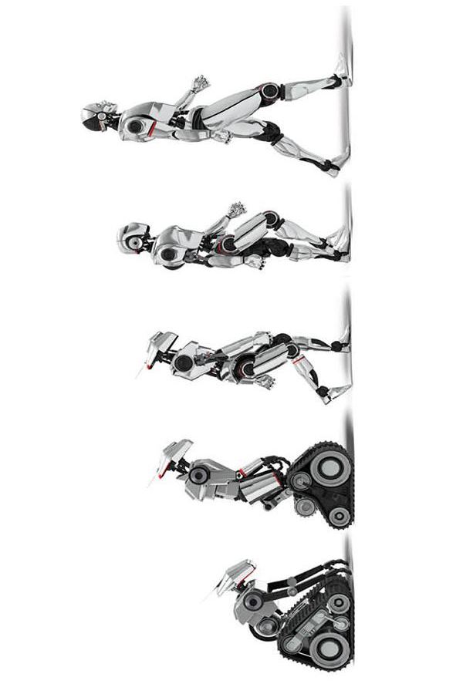
Future of AI in Music
A collaboration rather than a competition can be formed between AI and musicians.
Creating music will be easier than ever, replacing many entry-level jobs in the music industry.
Musicians will still stick around forever.

Slide 16
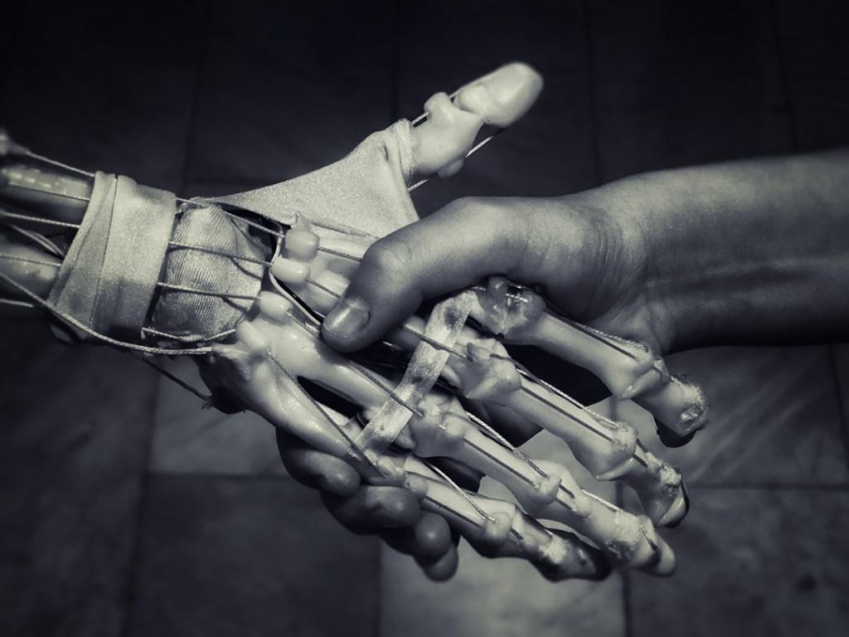
“Why have we done this? We have not done this because we think the world needs 100,000 new but mediocre tunes. We have not done this because we believe the rich tradition of music from Ireland in the UK is so simple that “even a computer can do it.” We have done this because we believe artificial intelligence can provide human creators and music practitioners with useful tools. In fact, we want to encourage anyone anywhere to use the material in this volume in any way.”
-Bob Sturm

Slide 17
Works Cited
Britz, Denny. “Recurrent Neural Networks Tutorial, Part 1 – Introduction to RNNs.”
WildML, 17 Sept. 2015, https://www.wildml.com/2015/09/recurrent-neural-
networks-tutorial-part-1-introduction-to-rnns/
2. Dickson, Ben. “AI Has Been Creating Music and the Results Are...Weird.” PCMag, 23
Dec. 2017, https://www.pcmag.com/news/357787/ai-has-been-creating-music-
and-the-results-are-weird
3. Dickson, Ben. “What is Machine Learning?” BD Tech Talks, 28, Aug. 2017, https://
bdtechtalks.com/2017/08/28/artificial-intelligence-machine-learning-deep-
learning/
4. Maladkar, Kishan. “6 Types of Artificial Neural Networks Currently Being Used in
Machine Learning.” Analytics India Magazine, Jan. 2018, https://analyticsindia
mag.com/6-types-of-artificial-neural-networks-currently-being-used-in-todays-
technology/
5. Sturm, Bob L. “Folk-rnn Session Tunes, Volume 1 of 10.” High Noon GMT, 12, Sept.
2016, https://highnoongmt.wordpress.com/2016/09/12/folk-rnn-session-tunes-
volume-1-of-10/

